Slide 1
Mastering Service Orchestration: How Saxo Blueprint Leverages Kubernetes Operators and GitOps
Jimmi Hested

Slide 2
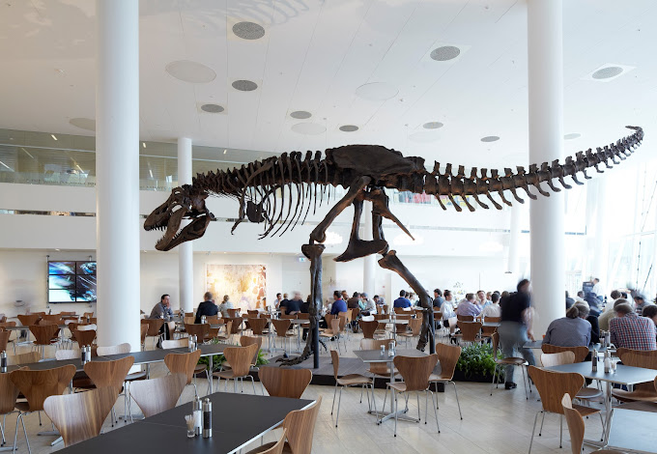
Saxo Bank
Founded in Copenhagen in 1992
Pioneered Online Trading in 1998
Global Presence: Trusted by over 1 million clients worldwide, with USD 100 billion in client assets and operations in 15 countries.
Platform Excellence: Regulated access to 71,000+ financial instruments on award-winning platforms.
Notes:
Founded in Copenhagen (1992): Began with a vision to make global financial markets accessible to more people.
Pioneered Online Trading (1998): Launched one of Europe's first online trading platforms, offering professional-grade tools.
Global Presence: Trusted by over 1 million clients worldwide, with USD 100 billion in client assets and operations in 15 countries.

Slide 3
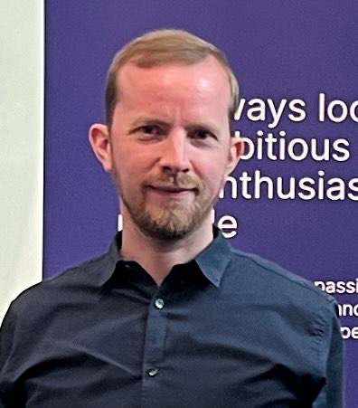
whoami
Jimmi Hested - Developer Platform Architect
3+ years with Kubernetes development
1+ year building Kubernetes operators
Active maintainer of internal Backstage instance
Formerly part of Saxo Bank’s Cloud Center of Excellence
10+ years of DevOps experience
15+ Developer
PowerPoint Wizard
Family, biking, and table tennis
Notes:
"Hi everyone, my name is [Your Name], and I’m a Developer Platform Architect at Saxo Bank, part of the Enterprise Architects team. Over the past three years, I’ve been deeply involved in Kubernetes as a developer, and for the past year, I’ve focused on building operators for Kubernetes, automating workflows and scaling services.
In addition to my Kubernetes work, I actively manage our Backstage instance, helping to streamline developer experiences across the organization. Before my current role, I was part of the Cloud Foundation team—now called the Cloud Center of Excellence—where I gained invaluable experience in cloud-native solutions and infrastructure.
Outside of work, I enjoy spending time with my family, biking, and playing table tennis. I’m excited to share with you today a project we’ve been working on called Service Blueprint, which aims to simplify and automate service management in Kubernetes environments.

Slide 4
Blueprint Overview
Centralized Configuration
The Service Definition serves as a single source of truth for each service, making it easier to manage and audit configurations.
Automation
The Blueprint automates the provisioning and management of services, reducing manual intervention and the risk of human errors.
Continuous Reconciliation
Following the Kubernetes Operator pattern ensures that services always align with the desired state.
Version Control
Version control for Service Definition files enables change tracking and auditing.
CI/CD Integration
Seamless integration with CI/CD pipelines streamlines the deployment process.
Notes:
Talk about approvals
Talk about pull re

Slide 5
Why Service Blueprint?

Slide 6
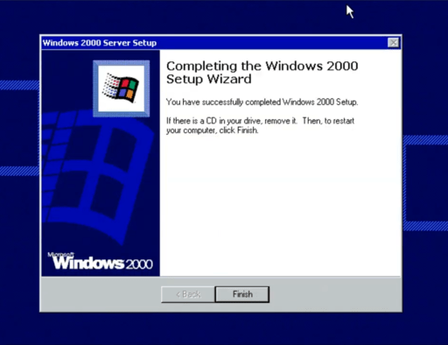
Notes:
Manual Installation

Slide 7

Classic Service Management
Manual identity and role assignments.
Complex firewall configurations.
DNS name setup.
Challenges with decommissioning services.
Security risks and inefficiencies.

Slide 8
Classic Resource Deployment
Complex and Inconsistent Process
Drift-Prone
Manual and Slow
Poor feedback
Difficult Disaster Recovery

Slide 9

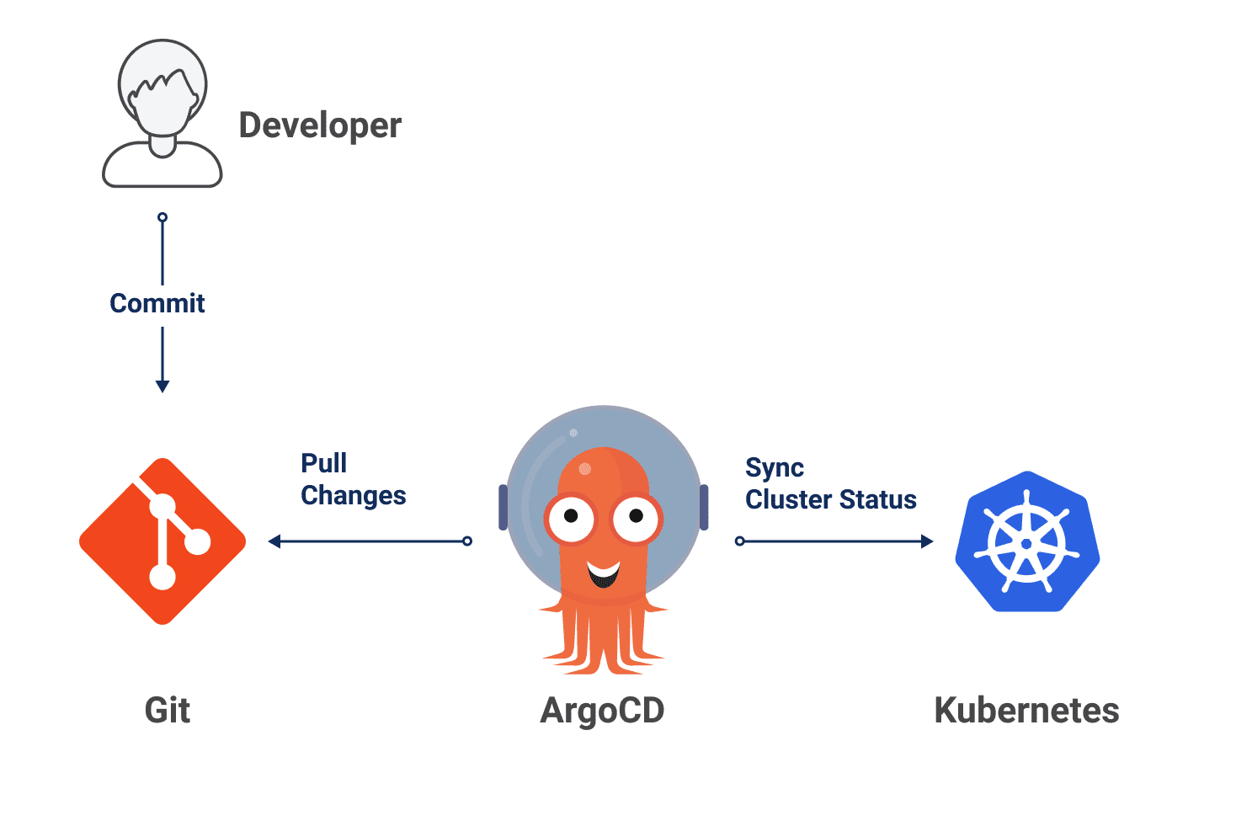
Kubernetes and GitOps

Slide 10
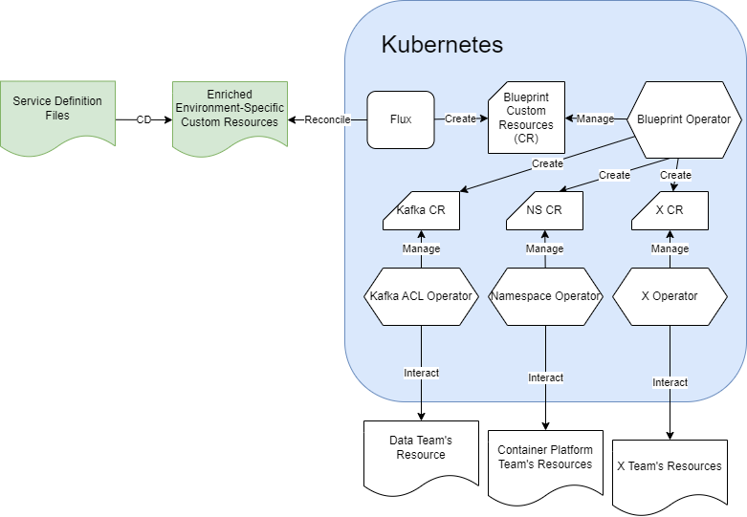
Blueprint Components
Service Catalog (YAML)
Blueprint Engine (Translation)
Custom Ressource Definition
Kubernetes Operator
External API / Existing Automation
Notes:
How Service Blueprint Solves It (5-7 minutes)
High-level overview of its architecture.
Key components:
Service Catalog (Git YAML repository)
BlueprintEngine (PowerShell)
Kubernetes Operators for automation.
Example workflows: turning a YAML catalog into automated Kubernetes deployments.
Highlight the automation benefits (e.g., reducing toil, improving reliability).

Slide 11
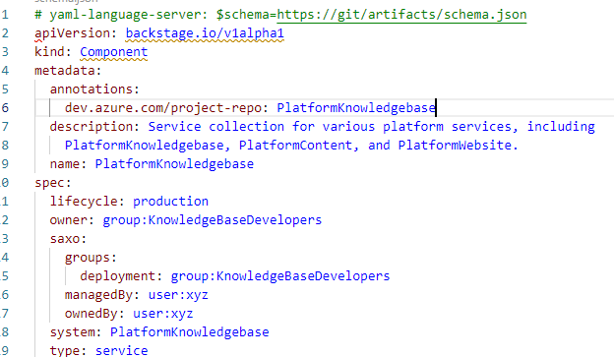
Service Catalog
Central repository hosted in GIT
Based on Backstage format
Built-in approvals via Pull Request Validation
Environment Invariant representation

Slide 12
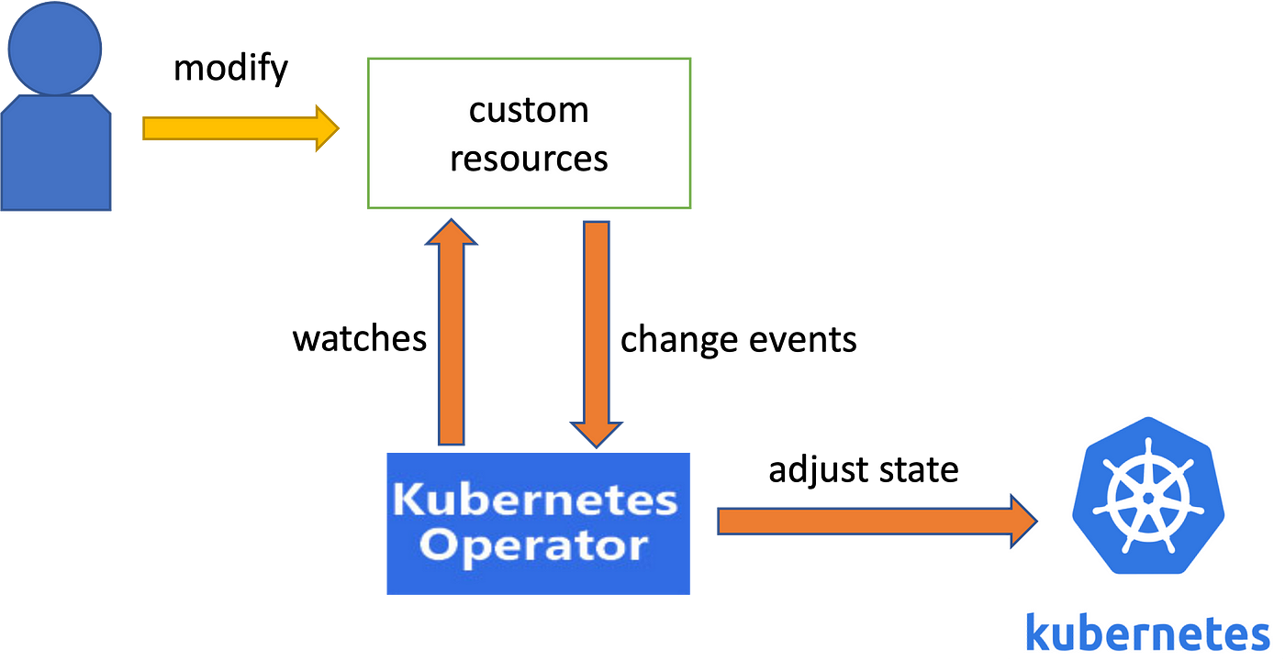
Operator Pattern
Notes:
Reconciliation loop
Eventual consistency

Slide 13


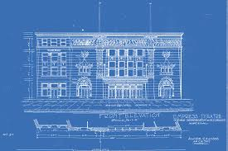


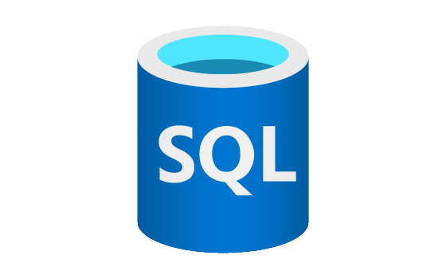
Blueprint Operator
”One slide to rule them all…”

Slide 14
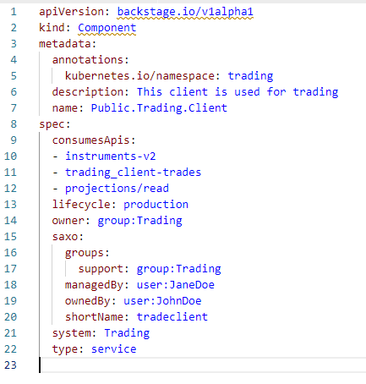
Blueprint

Slide 15

Blueprint
Namespace: trading

Slide 16

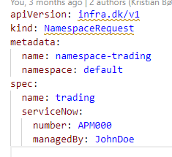
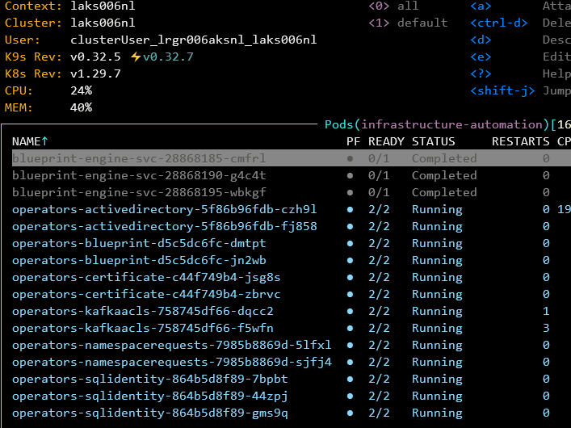
Blueprint
Namespace: trading

Slide 17
Blueprint
Namespace: trading
Identity: tradeclient

Slide 18
Blueprint
Namespace: trading
Identity: tradeclient
Topic: instruments-v2

Slide 19
Blueprint
Namespace: trading
Identity: tradeclient
Topic: instruments-v2
Database: trading

Slide 20
Blueprint
Namespace: trading
Identity: tradeclient
Topic: instruments-v2
Database: trading
API: projections/read

Slide 21
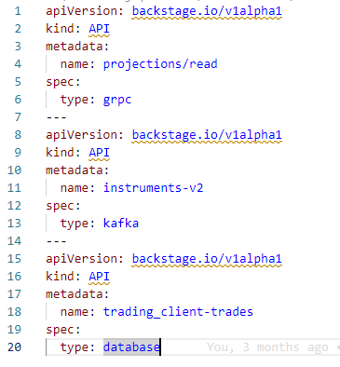
Blueprint

Slide 22

Delegate Responsibility

Slide 23
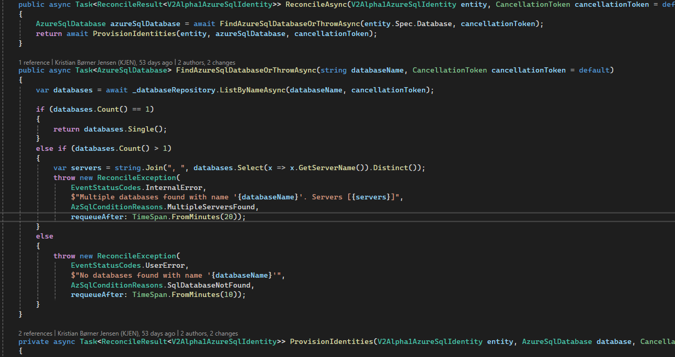
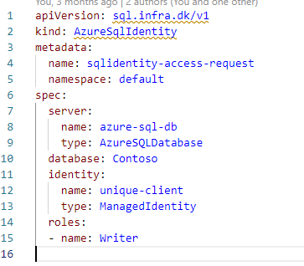
Resource Operator

Slide 24
What about monitoring?

Slide 25
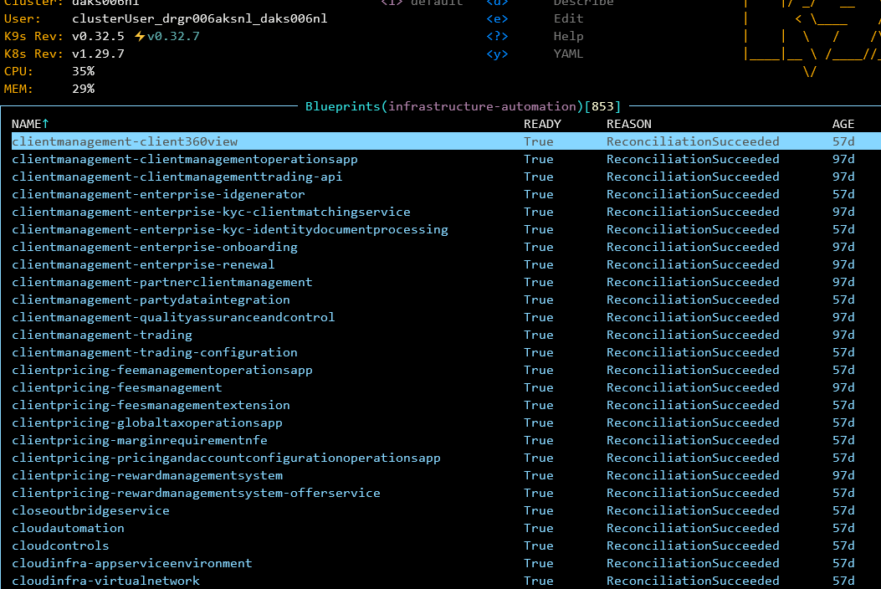

Slide 26
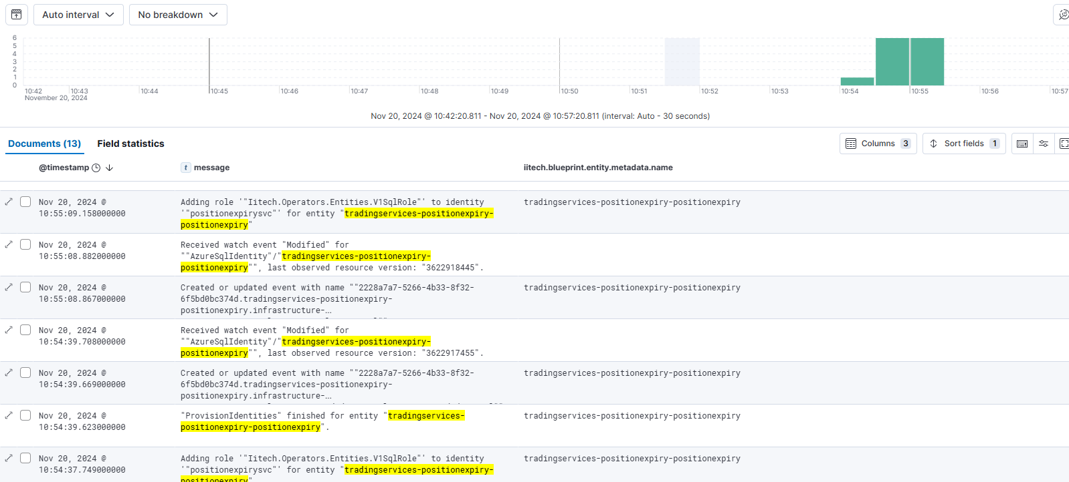

Slide 27
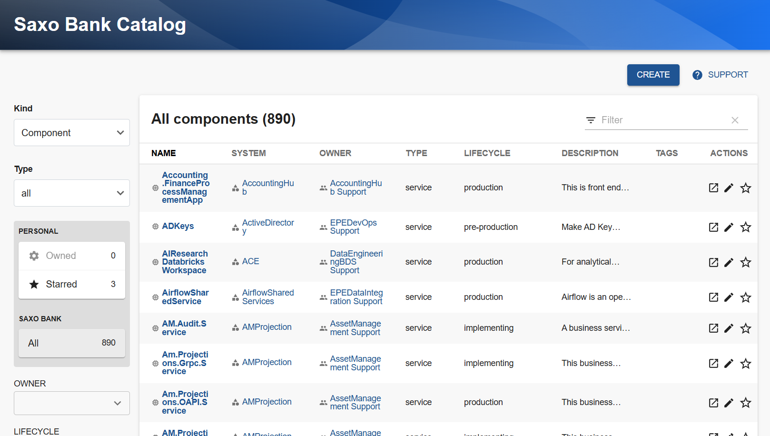

Slide 28
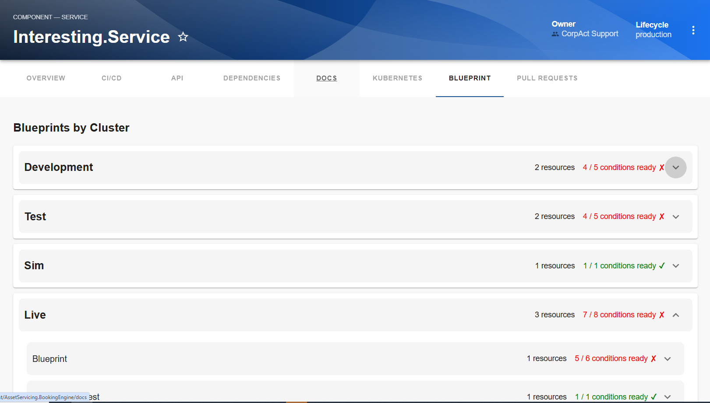

Slide 29
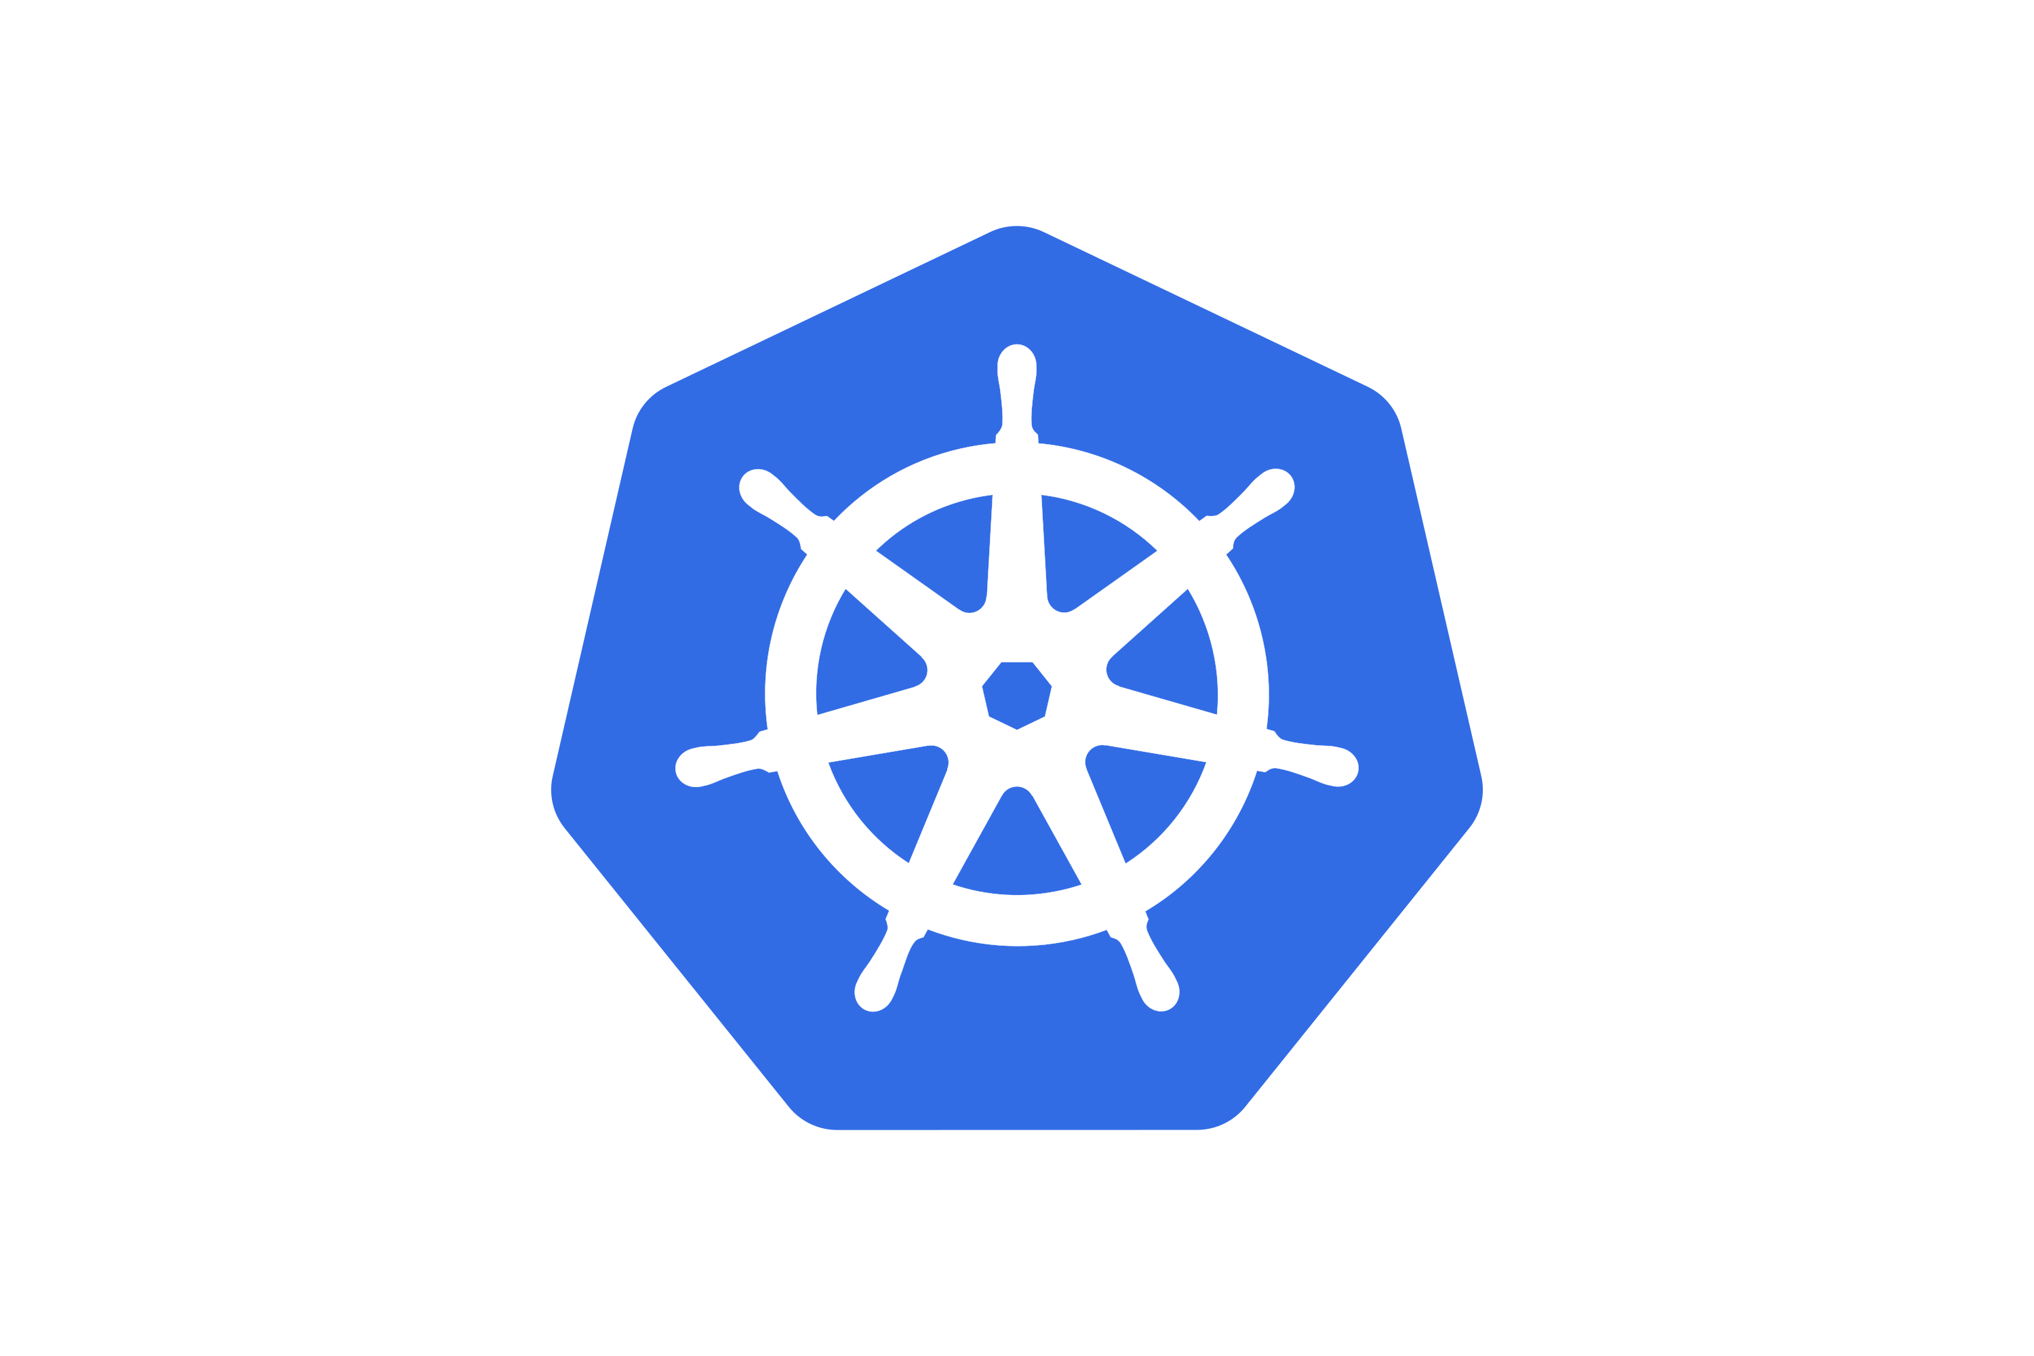


Current State
850
54
200+
100+
300+

Slide 30

Demo
If the internet god is with me…

Slide 31
Next Step
Certificate
DNS
Firewall

Slide 32

Classic Service Management
Manual identity and role assignments.
Complex firewall configurations.
DNS name setup.
Challenges with decommissioning services.
Security risks and inefficiencies.

Slide 33
Classic Service Management
Identity and role assignments auto provisioned.
Firewall automation.
DNS automation.
Challenges with decommissioning services.
Security risks and inefficiencies.

Slide 34
Classic Resource Deployment
Complex and Inconsistent Process
Drift-Prone
Manual and Slow
Poor feedback
Difficult Disaster Recovery

Slide 35
Classic Resource Deployment
Simple and consistent Process
Drift-Prone
Manual and Slow
Timely feedback
Difficult Disaster Recovery

Slide 36

Notes:
We as an organization learns similarly like a human. Cloud computing offers rich range of choices, but it’s still up to us to use it wisely.
There might still be a lot of things we don't know, but we are positive that we are ready for the change should the need raises.

Slide 37


Notes:
What's this nonsense, who are you anyway

